Slide 1
Tutorial 1: Getting Started with HTML5
Creating a Product Page for a Small Business

Slide 2
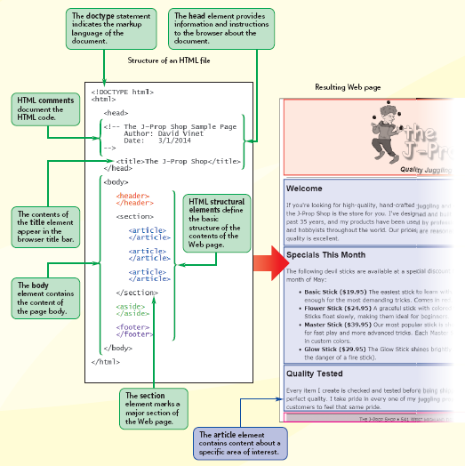
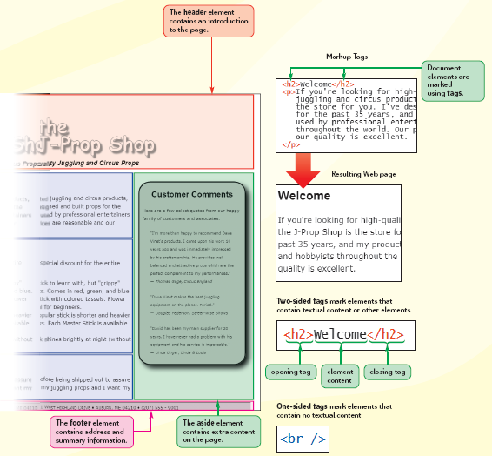
VISUAL OVERVIEW

Slide 3
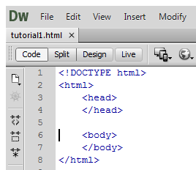
Create the basic structure of an HTML document
Start your text editor, opening a blank text document
Type the following lines of code in your document.

Slide 4
Add a title, comment to your Web page
Click at the end of the opening <head> tag, and then press the Enter key to insert a new line in your text editor.
Type <title>The J-Prop Shop</title>
Click at the end of the opening <head> tag, and then press the Enter key to insert a new line in your text editor directly above the opening <title> tag.
<!-- The J-Prop Shop Sample Page
Author: your name
Date: the date
-->
Save your changes to the jprop.htm file
Start your Web browser

Slide 5
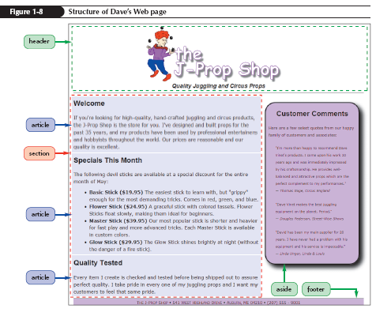
Defining the Structure of the Page Body

Slide 6
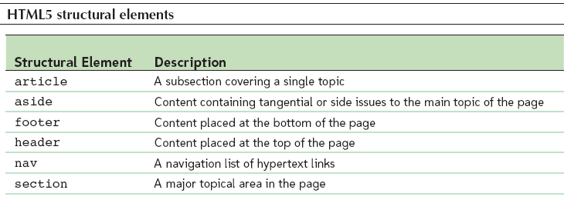
Working with HTML5 Structural Elements

Slide 7
Insert the HTML5 structural elements
Return to the jprop.htm
Within the body element, insert the following tags
<header>
</header>
<section>
</section>
<aside>
</aside>
<footer>
</footer>
Within the section element, insert the following code
<article>
</article>
<article>
</article>
<article>
</article>

Slide 8
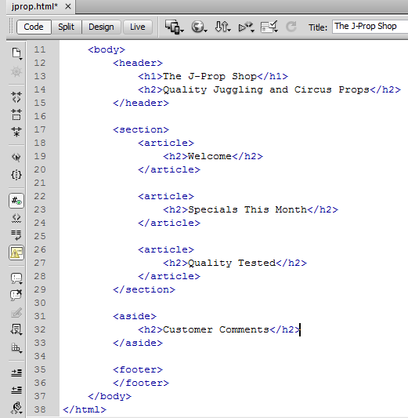
Add headings to document
Within the header element, insert the following tags:
<h1>The J-Prop Shop</h1>
<h2>Quality Juggling and Circus Props</h2>
Within the first article element, insert the following h2 heading:
<h2>Welcome</h2>
Within the second article element, insert
<h2>Specials This Month</h2>
Within the third and final article element, insert
<h2>Quality Tested</h2>
Finally, within the aside element, insert
<h2>Customer Comments</h2>

Slide 9
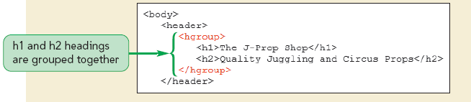
Group the first two headings in the document
Indent the first two headings in the document and then enclose them within <hgroup> tags

Slide 10
Add four paragraphs to Web page
Directly below the h2 heading Welcome, insert the following paragraph code
<p>If you're looking for high-quality, hand-crafted juggling and circus products, the J-Prop Shop is the store for you. I've designed and built props for the past 35 years, and my products have been used by professional entertainers and hobbyists throughout the world. Our prices are reasonable and our quality is excellent. </p>
Directly below the h2 heading Specials This Month, insert the following:
<p>The following devil sticks are available at a special discount for the entire month of May: </p>
Directly below the h2 heading Quality Tested, insert the following:
<p>Every item I create is checked and tested before being shipped out to assure perfect quality. I take pride in every one of my juggling props and I want my customers to feel that same pride. </p>
Finally, below the h2 heading Customer Comments, insert the following:
<p>Here are a few select quotes from our happy family of customers and associates: </p>

Slide 11
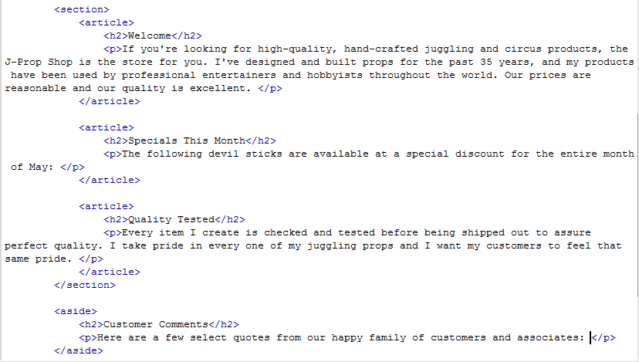

Slide 12
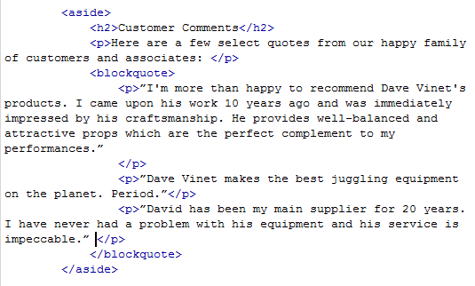
Create the customer comment block quotes
Scroll down to the aside element, and after the paragraph within that element, insert the following block quote
<blockquote>
<p>”I'm more than happy to recommend Dave Vinet's products. I came upon his work 10 years ago and was immediately impressed by his craftsmanship. He provides well-balanced and attractive props which are the perfect complement to my performances.” </p>
<p>”Dave Vinet makes the best juggling equipment on the planet. Period.” </p>
<p>”David has been my main supplier for 20 years. I have never had a problem with his equipment and his service is impeccable.” </p>
</blockquote>

Slide 13
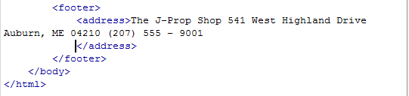
Add the J-Prop Shop address
Scroll down to the bottom of the file, and then within the footer element insert the following code
<address>The J-Prop Shop
541 West Highland Drive
Auburn, ME 04210
(207) 555 – 9001
</address>

Slide 14
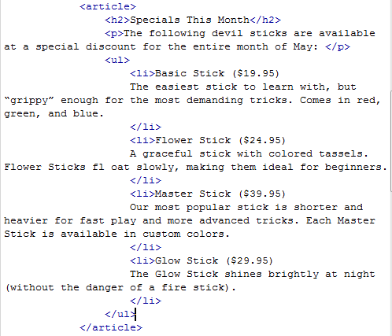
Add an unordered list to Web page
Within the Specials This Month article, directly below the p element, insert the following code
<ul>
<li>Basic Stick ($19.95)
The easiest stick to learn with, but “grippy” enough for the most demanding tricks. Comes in red, green, and blue.
</li>
<li>Flower Stick ($24.95)
A graceful stick with colored tassels. Flower Sticks fl oat slowly, making them ideal for beginners.
</li>
<li>Master Stick ($39.95)
Our most popular stick is shorter and heavier for fast play and more advanced tricks. Each Master Stick is available in custom colors.
</li>
<li>Glow Stick ($29.95)
The Glow Stick shines brightly at night (without the danger of a fire stick).
</li>
</ul>

Slide 15
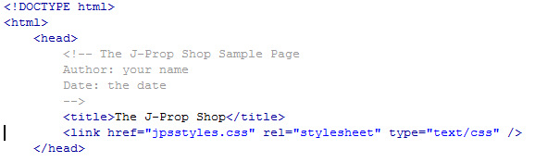
Apply external style sheet
Within the head element at the top of the file, insert the following link element
<link href=”jpsstyles.css” rel=”stylesheet” type=”text/css” />

Slide 16
Link to the Modernizr file
Scroll to the top of the file and add the following tag pair above the link element
<script src=”modernizr-1.5.js”></script>

Slide 17
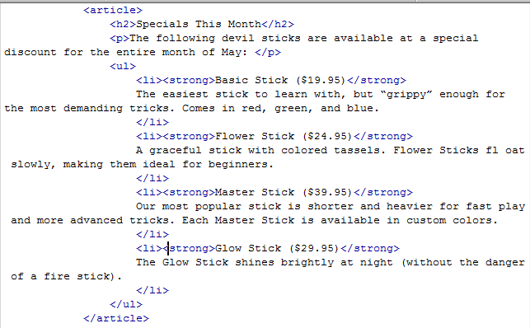
Mark strong text
Scroll down to the unordered list and enclose the name and price of each product within a set of <strong> tags

Slide 18
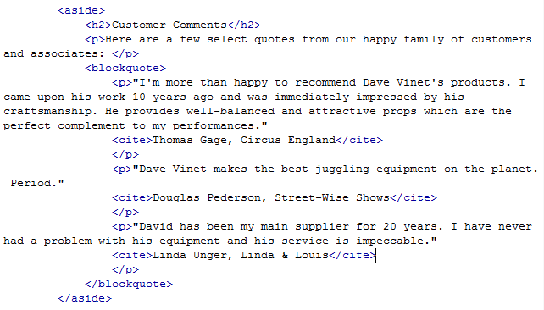
Append customer names to the Customer Comments section

Slide 19
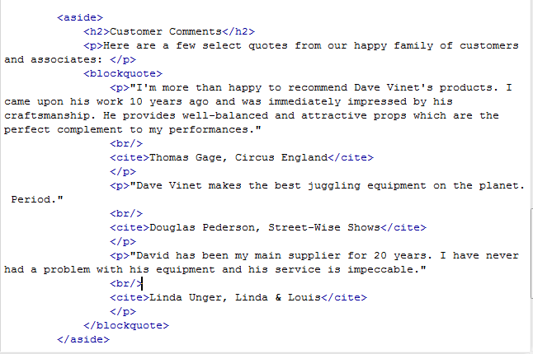
Insert line breaks in the comments
Insert the tag <br /> between the comment and the citation for each of the three customer comments

Slide 20
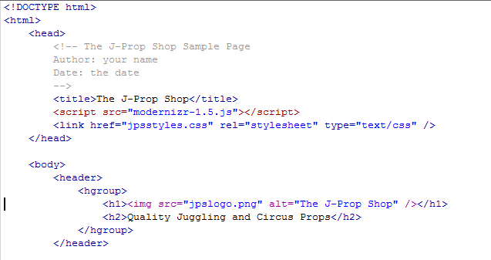
Insert the company logo at the top of the page
Go to the h1 heading element at the top of the body section, delete the text The J-Prop Shop from between the opening and closing <h1> tags, and then replace it with
<img src=”jpslogo.png” alt=”The J-Prop Shop” />

Slide 21
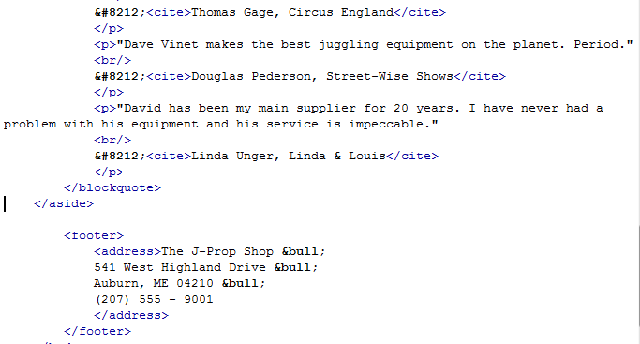
Add bullets and an em-dash to Web page
Locate the customer comment from Thomas Gage, and then directly before the opening <cite> tag insert the character code &#8212; followed by a space.
Repeat Step 2 for the two remaining customer comments
Scroll down to the address element within the page footer. At the end of each line within the address (except the last line), insert a space followed by the &bull; character entity.

Slide 22
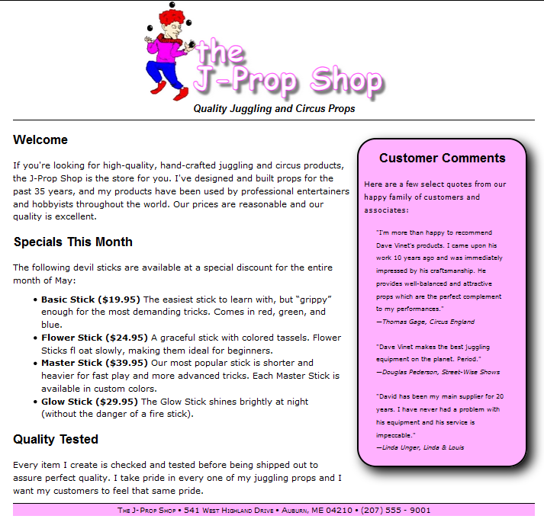
Specify the character encoding for document
Scroll to the top of the file. Directly below the comment in the head section, insert the following meta element <meta charset=”UTF-8” />
Refresh the jprop.htm file in your Web browser to show the final content

